Slide 1



High Impact Skills Development Program in
Data Science and Artificial Intelligence
GBIT and NUST Pakistan
RESUMEWISE
Capstone Project : DSAI Program
Presented by: Faiza Ali
Section: 01

Slide 2


OUTLINE
01
02
03
Problem Statament
Data Preprocessong
Methodology
04
05
06
Model Architecture
Evaluation Metrics and Results
Conclusion

Slide 3





PROBLEM STATEMENT (CONT...)
The process to handle incoming resumes,
Usually handled by Human(HR)
Depends more on reading capacity of person and costly
Time consuming and boring
More prone to errors as his/her resume was either missed or was misread
Chances are we miss out any record of shortlisting resume
We are too delayed in calling right candidate

Slide 4
SOLUTION
The purpose of this project is to create a tool that uses Natural Language Processing (SpaCy) techniques to analyze and extract relevant information from resumes.

Slide 5

Methodology 1 for Classification
Data Collection
I gathered diverse resumes from various sources.
Cleaning and standardizing the data to remove noise and ensure consistency.
Data Preprocessing
Utilization of NLP techniques
okenization and named entity recognition, to extract information.
classification: Identifying key skills and qualifications and other major relevant information.
Machine learning Models
Developing a user-friendly web interface using Streamlit
for users to input resumes and receive analysis reports.
User Interface

Slide 6
Methodology 2 for Parsing
Use SPacy trained dataset in .pkl format with more than 200 resumes
Data Collection
new NER pipeline is created and added to the pipeline
NER Pipeline Setup
extracting the entity labels from each annotation and adding them to the NER pipeline
Label Extraction:
model is trained
Model Training:
Loss Monitoring:
monitor the progress of the training and identify potential issues

Slide 7



DATA PREPROCESSING DETAILS

Slide 8
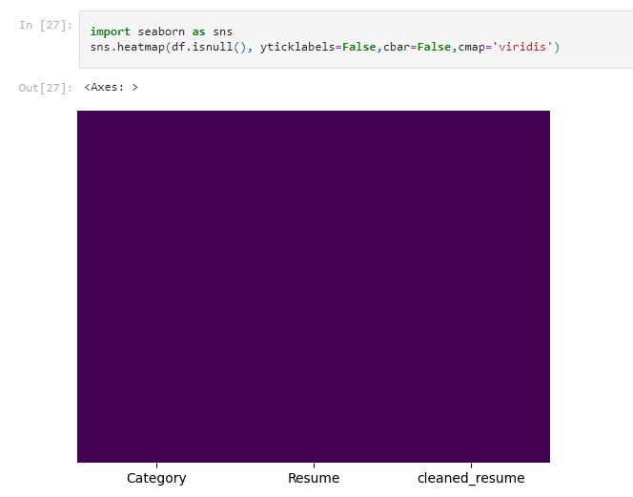

Slide 9
ADVANCED
EDA - QUANTITATIVE ANALYSIS

Slide 10
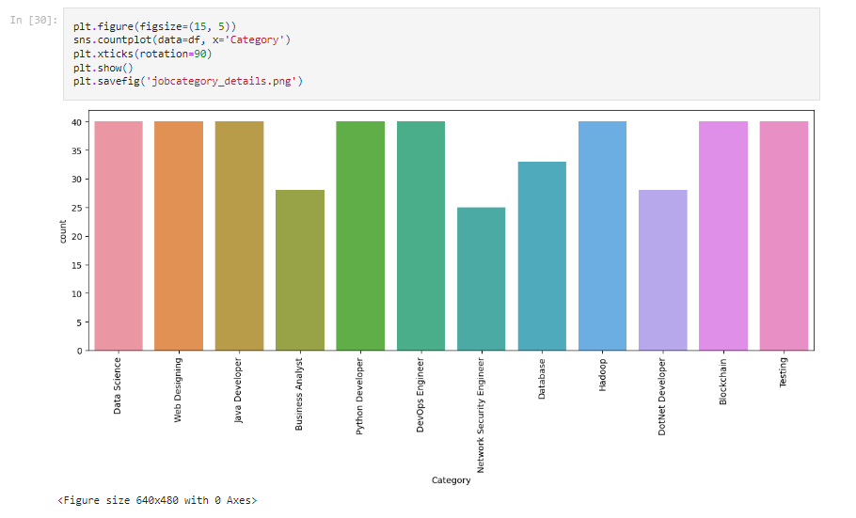

Slide 11
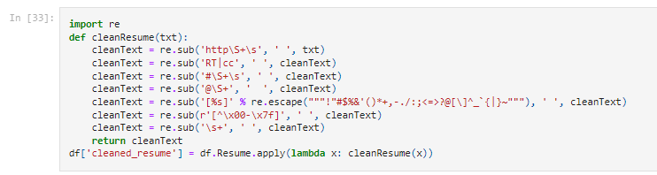
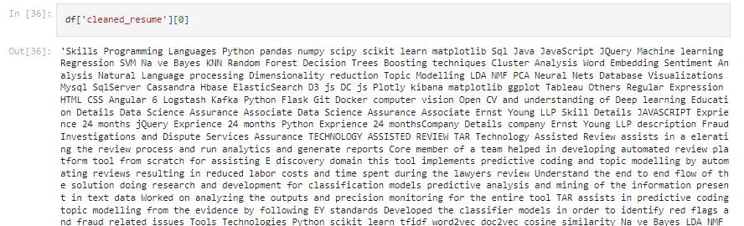

Slide 12
ADVANCED
EDA - QUALITATIVE ANALYSIS

Slide 13
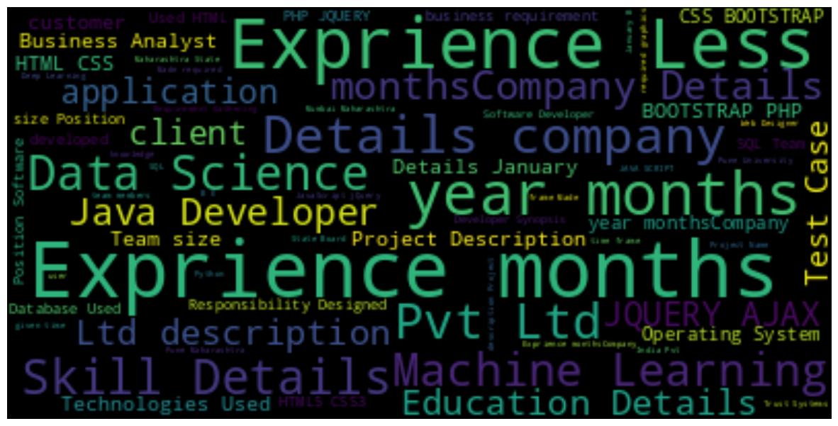
Cleaned Data Wordcloud

Slide 14
MODEL SELECTION FOR CLASSIFICATION
K-Nearest Neighbors (KNN) classifier
with One-vs-Rest (OVR) multiclass classification
MODEL SELECTION FOR PARSER
SpaCy NER Model

Slide 15
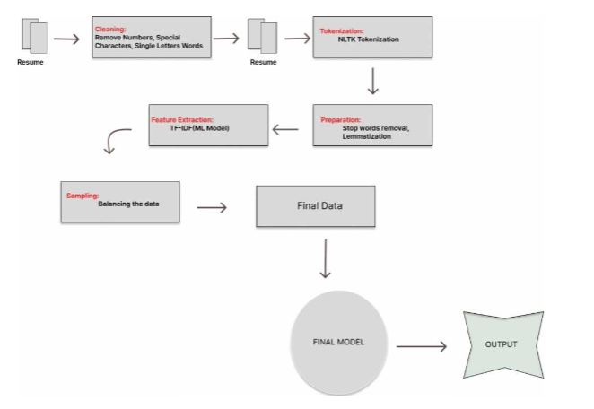
MODEL ARCHITECTURE CLASSIFICATION

Slide 16
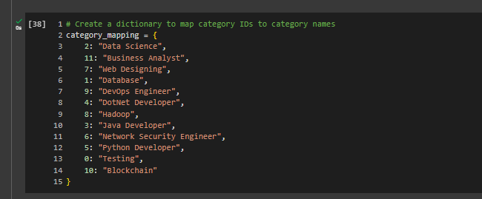

Slide 17
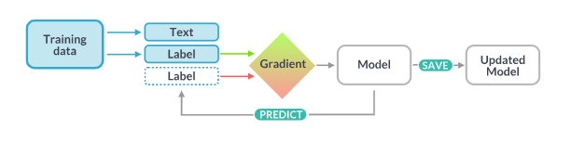
MODEL ARCHITECTURE PARSER

Slide 18
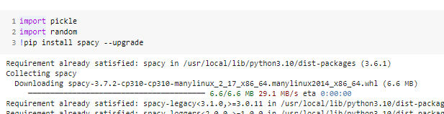
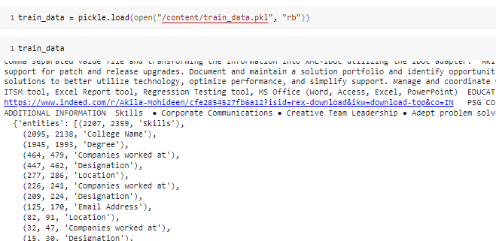

Slide 19
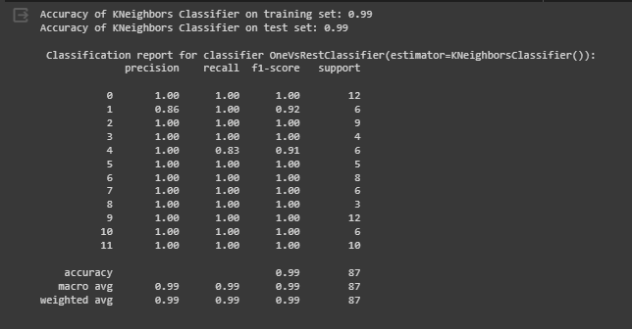
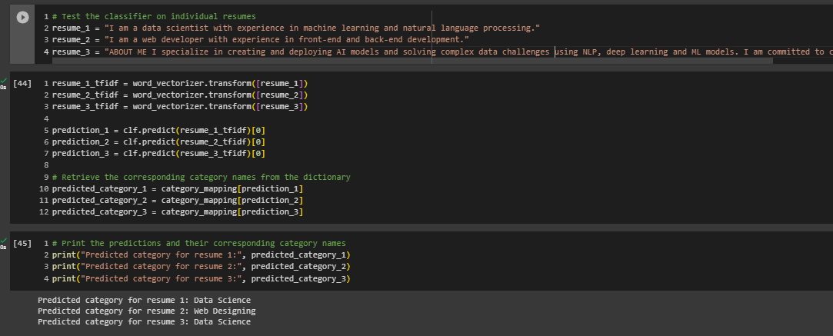

Slide 20





PROJECT ACHIVEMENT
Classification model can classify the resume into the specific Category
SpaCy NER model can now extract the required data from the resume

Slide 21



Thank You!

